Slide 1
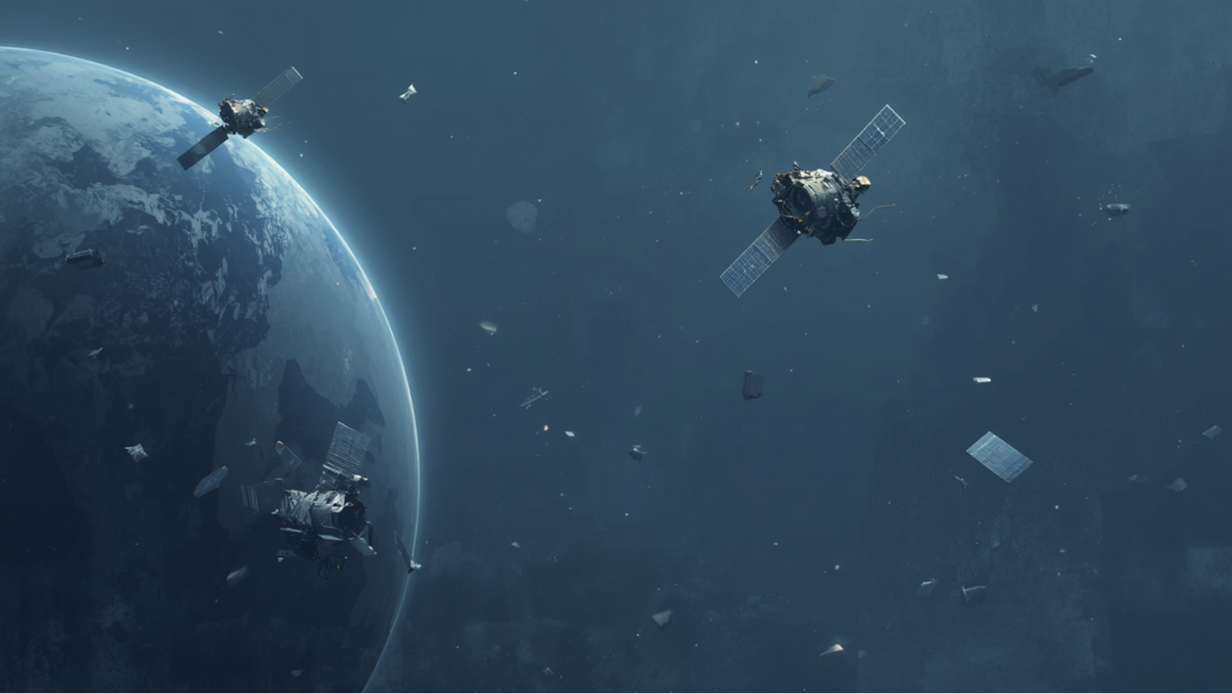



OrbitGuard
NEO-FLUX
31/01/2026

Slide 2

CNES#7: Clean the Cosmos:
Secure and Sustainable Space Operations

Slide 3
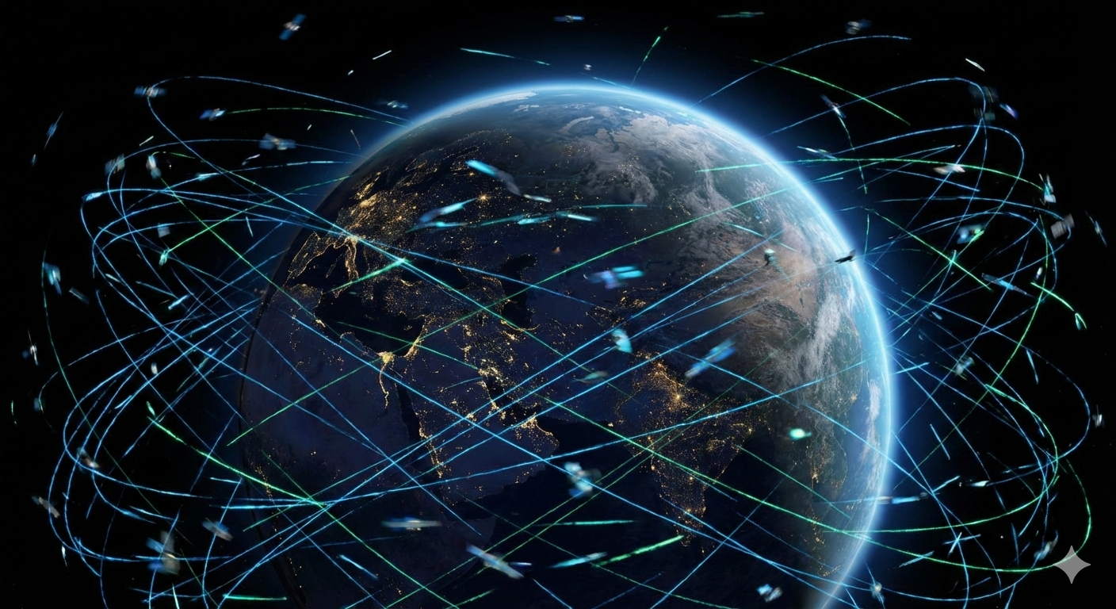
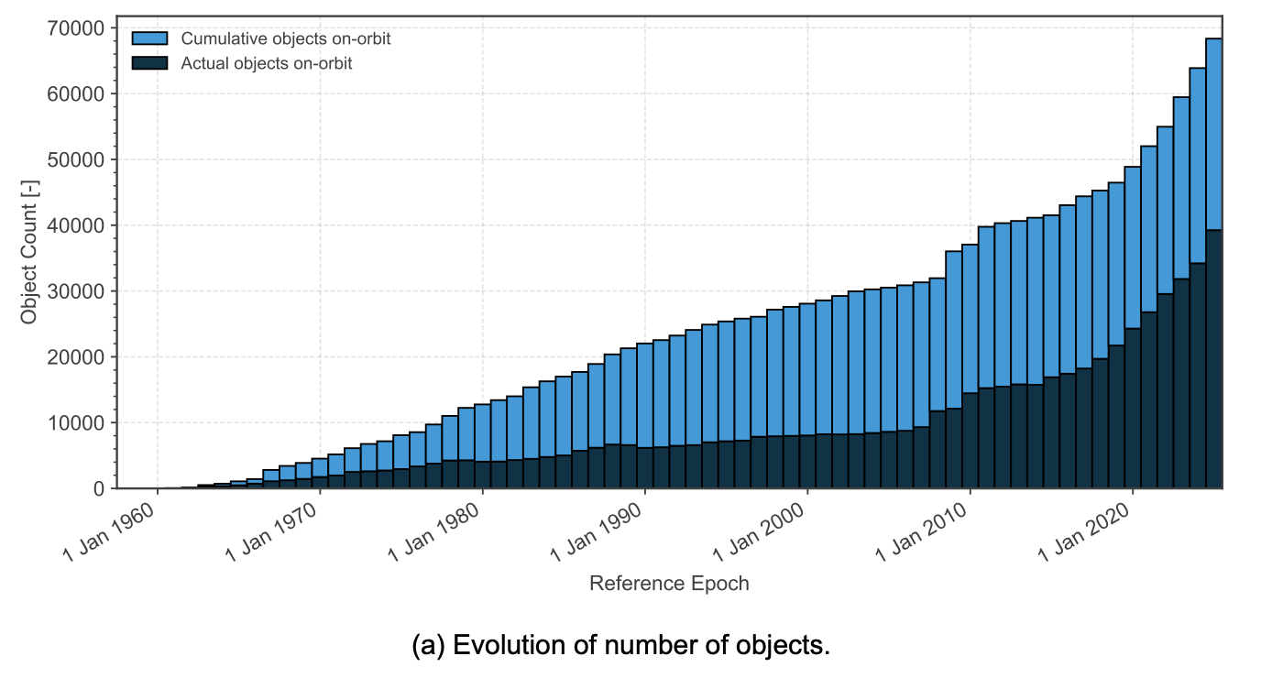
CURRENT CONTEXT
High Risk of Debris Collision
12,000+ Satellites in orbit (WEF, 2026)
Exp. 100,000 Satellites in 2030s (ESA, 2025)
Millions of Space Debris Objects
(ESA, 2025)
Starlink performed 300,000 avoidance manoeuvres in 2025 (SpaceX, 2025)
(ESA, 2025)

Slide 4

MAIN STAKES
99%
200+
$35B
Collision Alerts per week
per satellite [5][6]
Cumulative Losses due to
Orbital Congestion 2025-35
False Positives
600,000 per day industry wide [7]
Alert Desensitisation => Decision Fatigue
$25.8-42.3 Billion (WEF, 2026)

Slide 5




OUR TECHNICAL SOLUTION
AI agent for satellite operators which triages collision risk and offers decision support.
Machine Learning
Collision Risk Certainty
Facilitate Orbital Scaling
Sustainability: Mitigating creation of space debris
in orbit by reducing operator decision fatigue

Slide 6
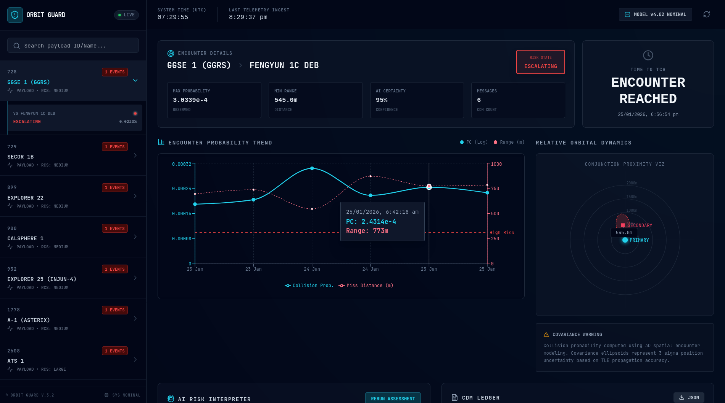
PRODUCT DEMO

Slide 7
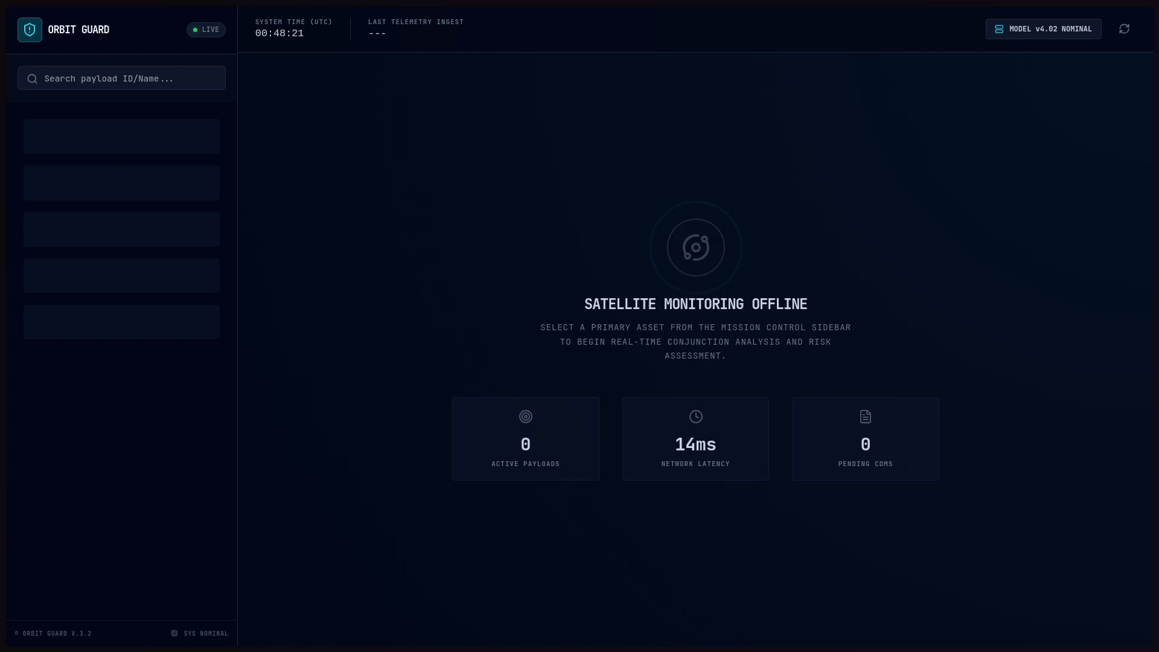
PRODUCT DEMO

Slide 8


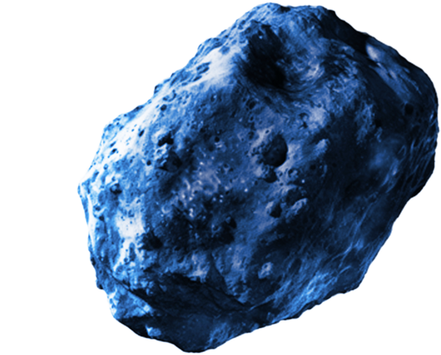

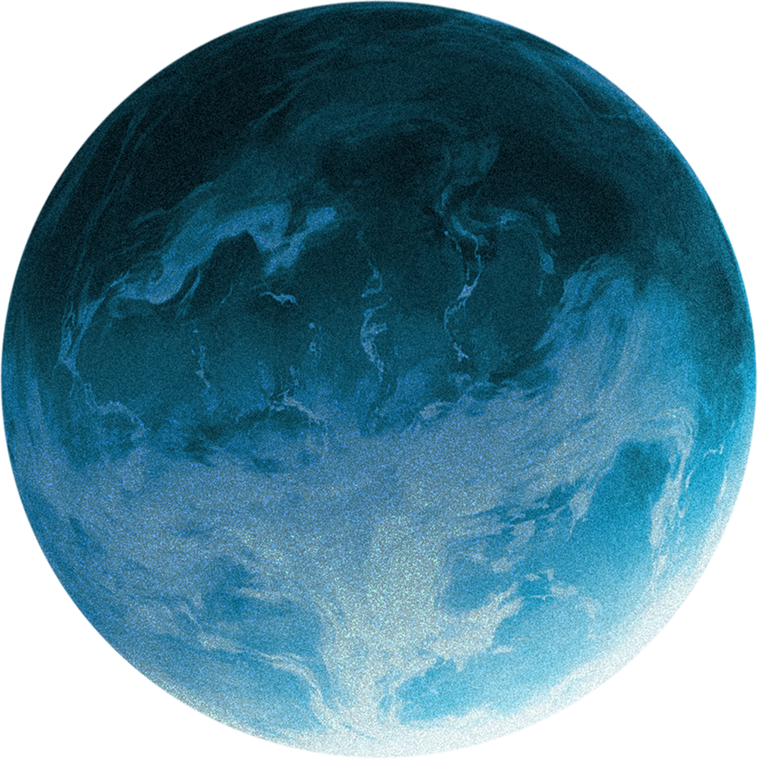



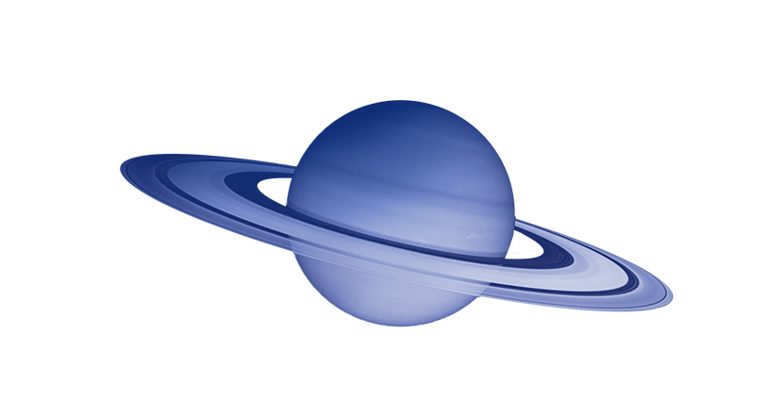
OUR BUSINESS MODEL CANVAS
KEY PARTNERS
CUSTOMER
SEGMENTS
Government Agencies
KEY ACTIVITIES
VALUE
PROPOSITIONS
CUSTOMER
RELATIONSHIPS
Orbital Data Providers
Machine Learning
Data ingestion
Government Space Agencies &. Defense
Reduced operator workload
Explainable AI
Model Validation
API Integration
Customer Support
Satellite Operators
AI Analysis of Collision Risk
Commercial Satellite Operators
Marketing
Customer Support
Feedback Loop
Cloud Infrastructure
Decision Confidence
Insurance Providers
Technology Providers
KEY RESOURCES
Fuel Efficiency /
Extended Mission Life
CHANNELS
Human Talent
APIs
Investors
Zero Waste Maneuvering
ROI Reports
Technological Infrastructure
International Space Events
AI Agents
Pilot Program
COST STRUCTURE
REVENUE STREAMS
Human Resources
Tiered SaaS
Data Acquisition
Startup – 1-10 Satellites – 50k / year
Cloud Infrastructure and Servers
Scale – 10-100 Satellites – 150k / year
Compute
Enterprise – 100+ Satellites – 500k / year
R&D
Insurance Risk Reports

Slide 9
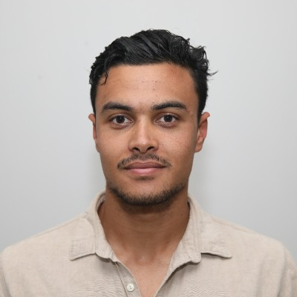
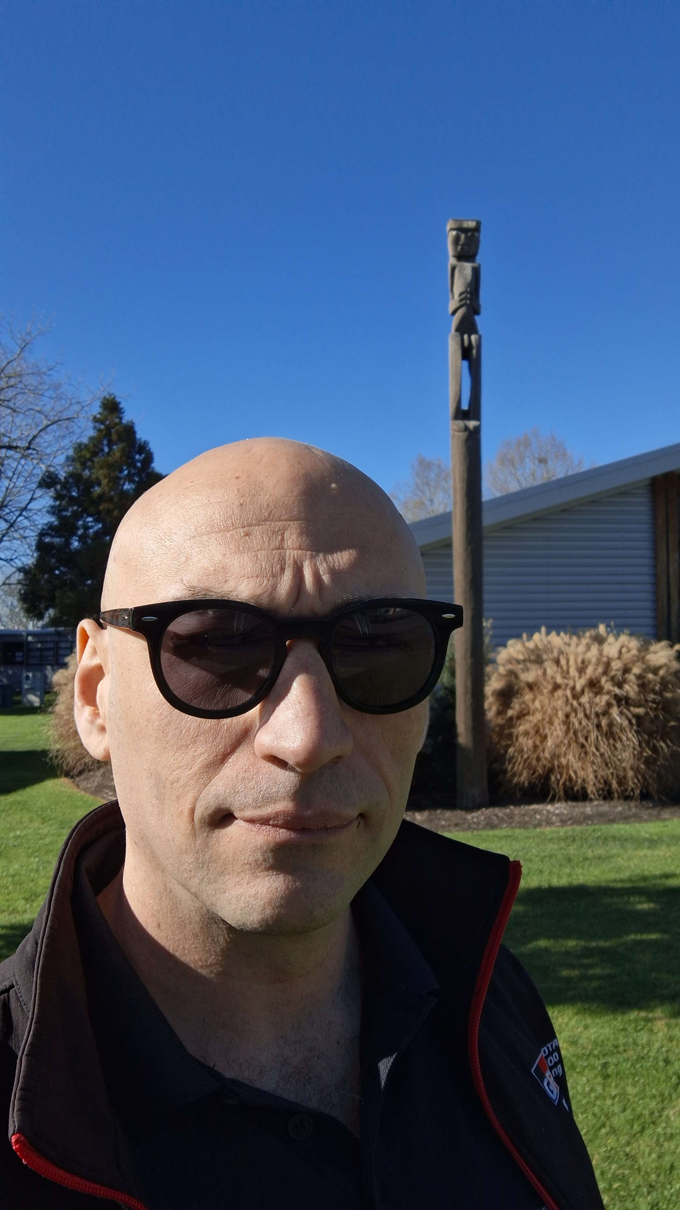

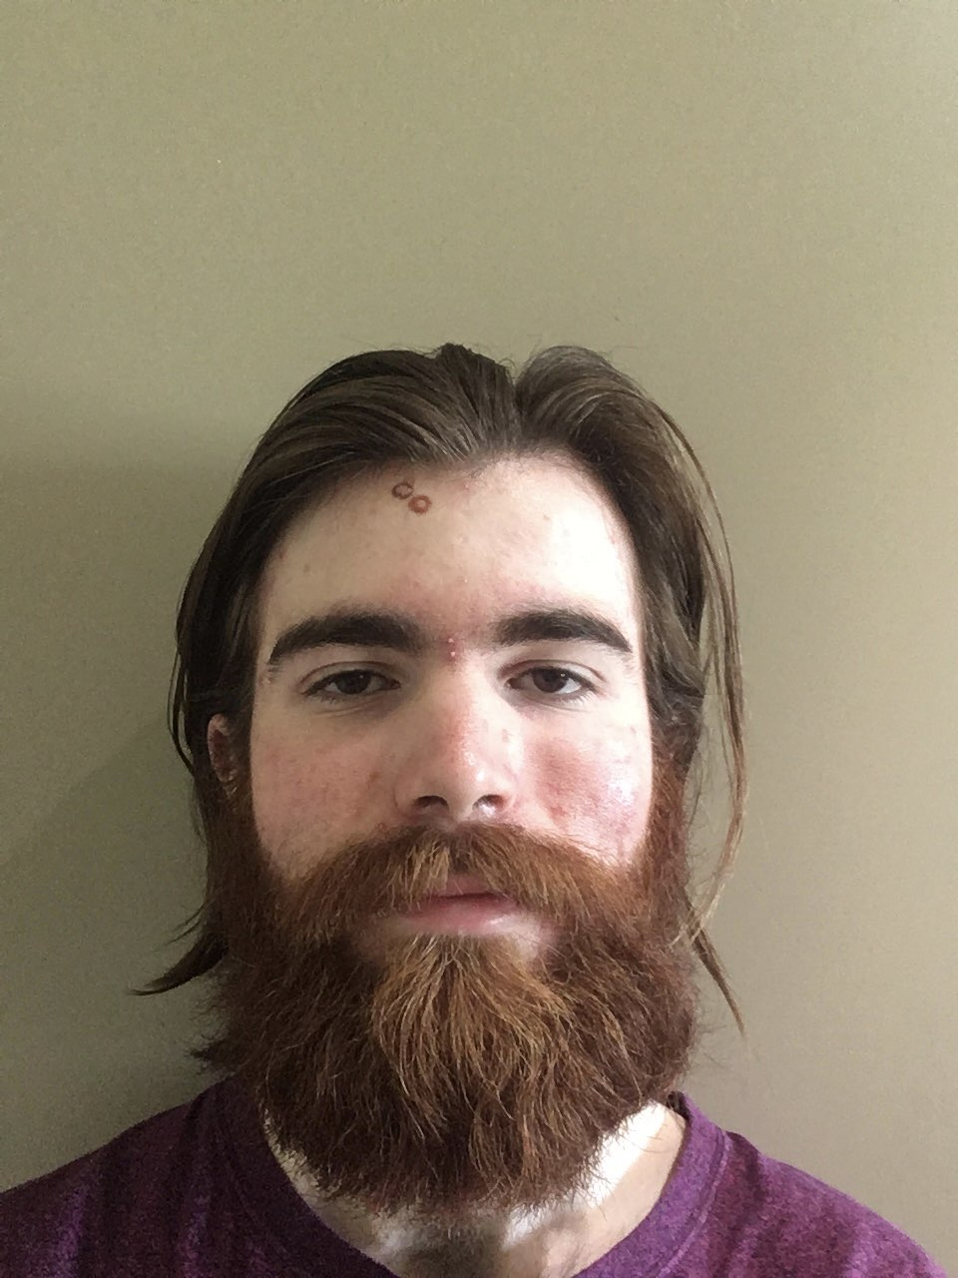
THANK YOU
AAYUSH PRAKASH
NATHAN RAWIRI
JONTY MCBREEN-GRAHAM
MOSTAFA SHERIF
MANAGER
AEROSPACE ENGINEER
SOFTWARE ENGINEER
MACHINE LEARNING
NEO-FLUX

Slide 10
REFERENCES
[1] World Economic Forum. (2026, January). Clear orbit, secure future: A call to action on space debris [insight report]. Saudi Arabia Centre for Space Futures.
[2] European Space Agency Space Debris Office. (2025, October 21). ESA’s annual space environment report (GEN-DB-LOG-00288-OPS-SD; Issue 9.1). European Space Operations Centre.
[3] European Space Agency. (2025, April). Around 100,000 satellites are expected to be in orbit by 2030. ESA Multimedia. https://www.esa.int/ESA_Multimedia/Images/2025/04/Around_100_000_satellites_are_expected_to_be_in_orbit_by_2030
[4] SpaceX. (2025, December 31). Semiannual constellation status report [Regulatory filing]. Federal Communications Commission.
[5] Seong, J., Jung, O., & Chung, D. (2020, September 15–18). Accuracy analysis of CDM for KOMPSAT series satellites. Advanced Maui Optical and Space Surveillance Technologies (AMOS) Conference, Maui, HI, United States. https://amostech.com/TechnicalPapers/2020/Poster/Seong.pdf
[6] European Space Agency. (2025, December 21). Automating collision avoidance. ESA Space Safety Office. https://www.esa.int/Space_Safety/Space_Debris/Automating_collision_avoidance
[7] Lewis, H. G., & Skelton, G. (2023, December). Safety considerations for large constellations of satellites. 2nd International Orbital Debris Conference, Houston, TX. https://www.sciencedirect.com/science/article/pii/S2468896724001150

